Slide 1
Web Development
Introduction

Slide 2
Introduction
Internet
World Wide Web
Web Page
Web Servers
Server-Side Programming
Web Browsers
Client-Side Programming
DNS – The Domain Name Service
HTTP

Slide 3
Internet
Late 1950s, U.S. government formed the Advanced Research Projects Agency (ARPA)
During the 1960s, the agency created a decentralized computer network known as ARPAnet
  Initially linked four computers located at
    The University of California at Los Angeles,
    Stanford Research Institute
    The University of California at Santa Barbara
    The University of Utah
Email was implemented in 1972
Telnet protocol for logging on to remote computers
File Transfer Protocol (FTP), enabling file transfer between computers
During 1989 Berners-Lee and his colleagues at the European particle physics laboratory CERN (Conseil Europeen pour le Recherche Nucleaire) proposed the concept of linking documents with hypertext that the now familiar World Wide Web began to take shape
The use of hypertext pages and hyperlinks helped to define the page-based interface model that we still regard as the norm for web applications today

Slide 4
What is internet?
The Internet is a worldwide collection of computer networks
connecting academic, governmental, commercial, and
organizational sites.
It provides access to communication services and
information resources to millions of users around the globe.
Internet services include:
  direct communication (e-mail, chat)
  online conferencing (Usenet News, e-mail discussion lists)
  remote login and file transfer (telnet, ftp)
  and many other valuable tools and resources
→ The Internet and the WWW are no synonyms

Slide 5

World Wide Web (WWW)
WWW also known as the web
Collection of hyperlinked text documents, audio, and video files, and remote sites etc.
Accessed via Internet, computers can contact each other
Public files on computers can be read by remote user
  usually Hypertext Markup Language (.html)
URL - Universal Resource Locator - is name of file on a remote computer
    http://www.microsoft.com

Slide 6
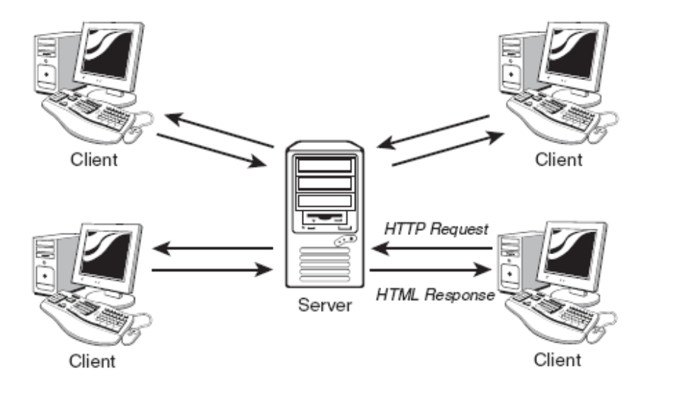
The World Wide Web
A world wide collection of electronic documents
The World Wide Web operates using a client/server networking principle

Slide 7
The World Wide Web
HTTP request contains several pieces of information needed so that your page may be correctly identified and served to you, including the following:
  The domain at which the page is stored (for example, mydomain.com)
  The name of the page (This is the name of a file in the web server’s file system - for example, mypage.html.)
  The names and values of any parameters that you want to send with your request

Slide 8
Web Page, Website
Each electronic document on Web is called a Webpage
Contain text, graphics, sound, video, and built-in connections
A website is a collection of web pages
Generally speaking, each web page is actually a separate file on the server. The collection of individual pages constituting a website is managed by a program called a web server

Slide 9
Web Fundamentals
Web Page
  Each page available on the website is called a web page.
  It is usually written in Hypertext Markup Language (HTML).
  It contains text, graphics, images, videos and may also contain hyperlinks to other web pages.
  It is identified by a unique URL (Uniform Resource Locator).
    URL is the the unique address of any document available on the web.
Website
  A collection of several related web pages written in HTML markup language.
Home Page
  The first page of any website is called home page.

Slide 10
Web Fundamentals (Con’t)
Web Server
A machine that responds to client requests and sends the requested page back to user.
popular web server software:
Apache: www.apache.org
Web Browser
  Web browser is a software tool used to access and search information on web.
  Some of popular web browser software are:
    Mozilla Firefox: getfirefox.co
    Microsoft Internet Explorer (IE): part of Windows
    Apple Safari: part of Mac OS X
    Opera: opera.com
    Google Chrome

Slide 11
Web Server
A web server is a program that interprets HTTP requests and delivers the appropriate web page in a form that your browser can understand
Examples
  Apache Web Server from the Apache Software Foundation (http://www.apache.org), an open source project used to serve millions of websites around the world
  Microsoft’s IIS (Internet Information Services), often used on host computers running the Microsoft Windows operating system

Slide 12
Server-Side Programming
Server-side programs, scripts, or languages, refer to programs that run on the server computer
Languages and Tools
  PHP, Java, and ASP
Server-Side scripting allows web pages to be served with rich and varied content that would be beyond the scope of any design using only static pages—that is, pages with fixed content

Slide 13
Client-Side Programming
Client-side programming, on the other hand, happens not at the server but right inside the user’s browser after the page has been received
Such scripts allow you to carry out many tasks relating to the data in the received page
  Calculations, changing display colors and styles, checking the validity of user input, and much more
JavaScript, a client-side programming language

Slide 14
DNS – The Domain Name Service
IP Address
  198.105.232.4
Domain Name
  www.somedomain.com
DNS Server
  Maps domain name to the corresponding IP
DNS servers around the Internet are connected together into a network that constantly updates itself as changes are made

Slide 15
Introducing HTTP
HTTP defines a set of rules regarding how messages and other data should be formatted and exchanged between servers and browsers
  HTTP Client – The Browser
  HTTP Server – Web Server
The HTTP Request and Response
  The HTTP protocol can be likened to a conversation based on a series of questions and answers, which we refer to respectively as HTTP requests and HTTP responses

Slide 16
The HTTP Request and Response
HTTP Request
  After opening a connection to the intended server, the HTTP client transmits a request in the following format:
    An opening line
    Optionally, a number of header lines
    Optionally, a message body
  Opening Line
    The opening line is generally split into three parts; the name of the method, the path to the required server resource, and the HTTP version being used.
      GET /sams/testpage.html HTTP/1.0
  Header lines
    Used to send information about the request, or about the data being sent in the message body. One parameter and value pair is sent per line, the parameter and value being separated by a colon
      User-agent: Mozilla/4.0
      Accept: text/plain, text/html

Slide 17
The HTTP Request and Response
The HTTP Response
  In answer to such a request, the server typically issues an HTTP response
  Status Line
    server echoes the HTTP version and gives a response status code (a three-digit integer)
  Reason Phrase
  HTTP/1.0 200 OK
  The response may also contain header lines each containing a header and value pair, containing information about the server and/or the resource being returned:
    Server: Apache/1.3.22
    Last-Modified: Fri, 24 Dec 1999 13:33:59 GMT

Slide 18
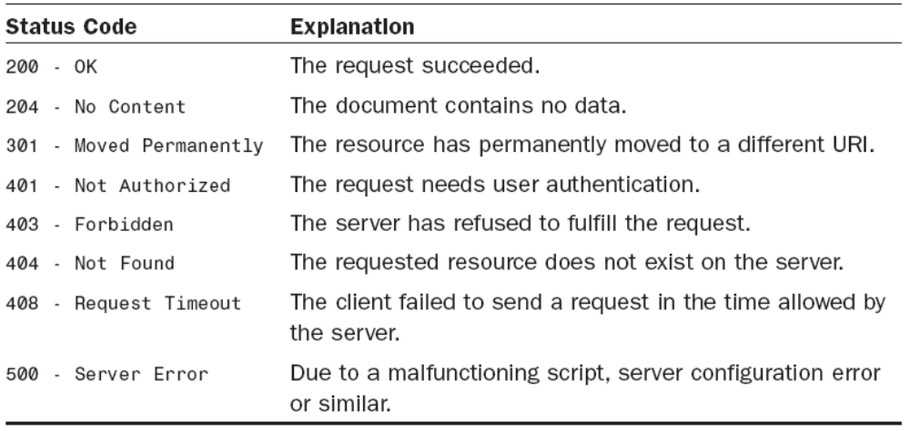
The HTTP Request and Response
Some Commonly Encountered HTTP Response Status Codes

Slide 19
URL
A URL is one type of Uniform Resource Identifier (URI); the generic term for all types of names and addresses that refer to objects on the World Wide Web. The term "Web address" is a synonym for a URL that uses the HTTP or HTTPS(Hypertext Transfer Protocol Secure) protocol.

Slide 20
Some Web programming technologies
Hypertext Markup Language (HTML/XHTML):
  used for writing web pages
Cascading Style Sheets (CSS):
  supplies stylistic info to web pages
  JavaScript: allows to program the behavior of web pages
  Hypertext Processor (PHP): allows the web server to create pages dynamically
Structured Query Language (SQL): interaction with databases

Slide 21
Websites Categories
Personal websites
  These websites are used by people for their personal use such as to share information about themselves or their products, to enhance their skills or post their curriculum vitae online to improve their chances of getting a job.
  Another most common use is to publish virtual journals called blogs that describe events in people’s lives, their interests and their personal opinions on different topics.
Professional websites
  These are created as portals that provide platform for businesses and provide information on their products and services. Some of these portals enable businesses to sell products online and act as virtual storefronts for receiving orders and payment.
  Such sites can directly generate revenue for businesses.

Slide 22
Websites Categories (Con’t)
Static websites are developed with fixed-content pages that do not contain any programmatically controlled content.
Fixed contents pages are pages with content that does not change dynamically.
The content will only change when the website designer manually modifies it.
Dynamic websites are driven by dynamic content that is loaded or created using programming and databases.

Slide 23
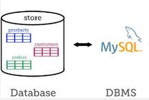
What is Database and Database Management System (DBMS)?
Database
  Collection of related data stored on a particular topic
  Storage and retrieval is in an organized and efficient way
  Examples: Hospital database, Library database, Student database etc.
Database Management System (DBMS)
  Collection of programs that allows users to create and maintain a database
  Examples: MS Access, MySQL, DB2, SQL Server etc.

Slide 24
Why is ‘Databases on the Web’ Important?
Databases are established technology for managing large amounts of data.
Achieving complete separation between your site's design and the content you want to present.
Interaction in real time

Slide 25
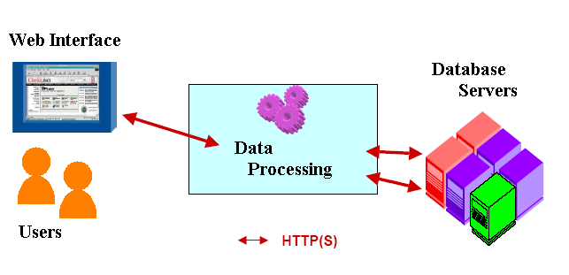
What is a database-driven Web site?
A database-driven Web site is a Web site that uses a database to gather, display, or manipulate information
Examples:
  News sites: CNN.com and MSNBC.com
  E-commerce companies: Amazon.com, which is a Web interface of a big-sized database system containing customer and transactional information.

Slide 26
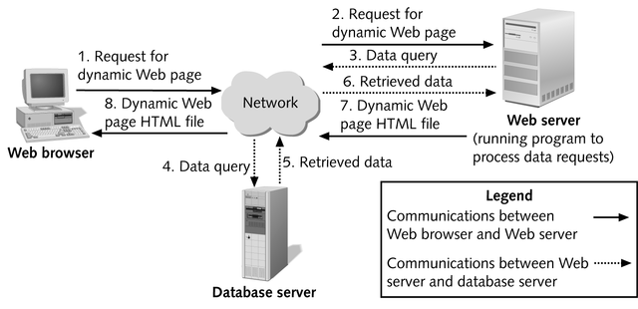
Database-driven Web site Architecture
HTTP request
Client
(Browser)
SQL query
Web
Server
HTML page
Database
Server
SQL result

Slide 27
How to Integrate Databases and the Web?
  Databases
    MS Access
    MySQL, mSQL
    Oracle, Sybase, MS SQL Server
  Integration tools
    PHP or CGI, Servlets, JSP, ASP etc.
  Common Gateway Interface (CGI) is a standard way for web servers to interface with executable programs installed on a server that generate web pages dynamically.

Slide 28
Home tasks
Describe the different type of the websites.
Explore the various option of your favorite Browser
Describe in detail for the Port.
Describe the sitemap.
Describe Storyboarding
What do you mean by a page layout? What are the technology available for preparing page layout? List the design point to be considered while preparing page layout.
Discuss the XHTML.

